Slide 1
The (Initial) Copyright Ownership within the Machine Learning Lifecycle
Whose Right is Copyright?
dr. sc. Dino Gliha
Joint Law Office
dr. sc. Marković, Grbavac & dr. sc. Gliha

Slide 2
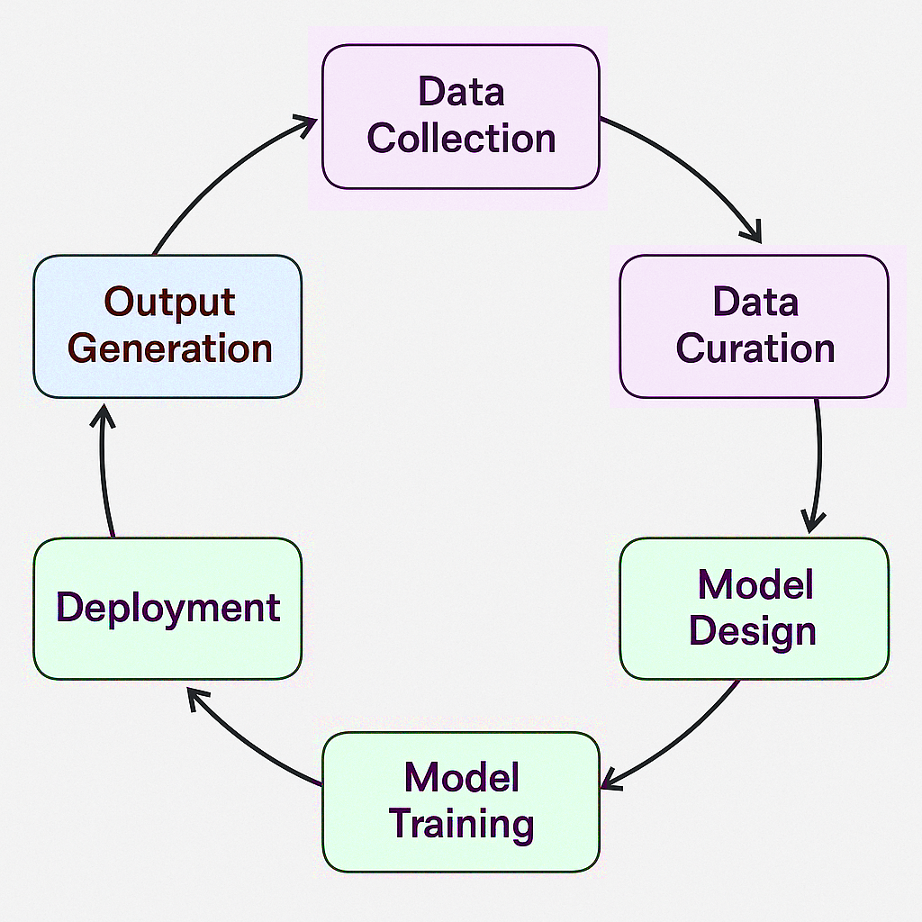
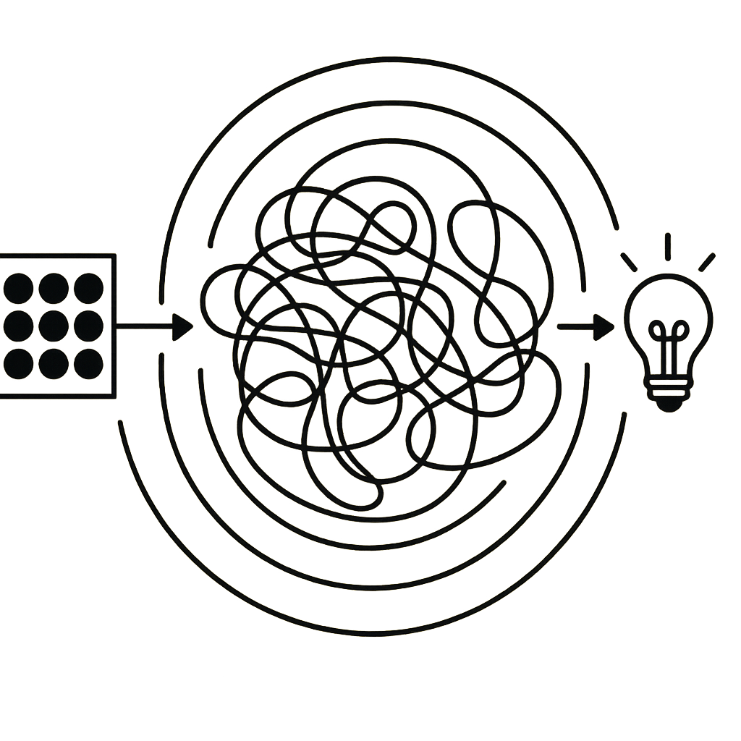

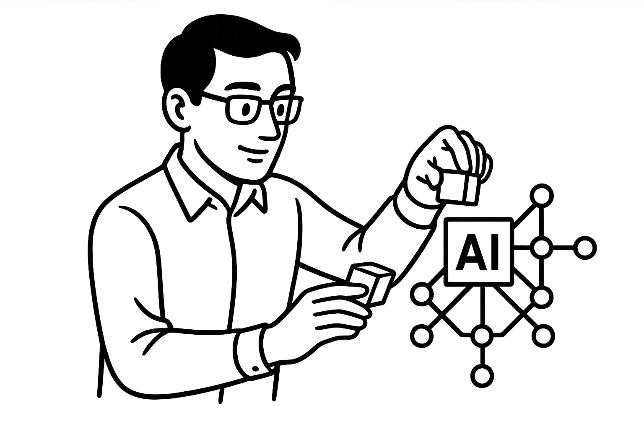
Machine Learning Lifecycle and Copyright

Slide 3
The Input Layer
ML Lifecycle Phase | Copyright Ownership Issues
➤ Dataset curation & preprocessing | Human intellectual choices—selection, arrangement, labeling, and transformation—may generate new copyright or database rights. Raises questions of authorship, derivative works, and possible moral rights implications in altered materials.

Slide 4
The Model Layer
ML Lifecycle Phase | Copyright Ownership Issues
➤ Model architecture design (source code) | Protection of source code and model design as original works — copyright subsists in programming and possibly in architectural structure. Also engages patentability of technical contributions.
➤ Model training and fine-tuning | Transformative use of data during training challenges the boundary between input use and new expression. The trained weights and parameters may embody creative and technical contributions, implicating joint copyright ownership and derivative rights discussions.

Slide 5
The Output Layer
ML Lifecycle Phase | Copyright Ownership Issues
➤ Output generation | Represents the AI–copyright interaction proper: questions of authorship, originality, and ownership of generated works. Raises the issue of human contribution — whether user input or model design suffices to establish authorship under existing standards.
 | Also implicates potential related rights for AI-assisted outputs and tests the limits of human authorship requirements in different legal systems.
 | Engages ethical, economic, and policy debates on whether current frameworks adequately allocate rights, incentives, and responsibilities in generative creation.

Slide 6

The key ingredients of AI proliferation:
The Way Forwards
Algorithms
Computing power
Data
Human

Slide 7
A work which is a fruit of a creator’s thoughts is the most personal, the most legitimate, the most unassailable, and the most sacred of all property! Holding in your hands that fruit of your labour is one of the most beautiful feelings one may have. No machine, VR, or digital something can replace or recreate this. - paraphrasing Le Chapelier, Report on Dramatic Author’s Property (Paris, 1791)

Slide 8
THANK YOU FOR YOUR ATTENTION!
dr. sc. Dino Gliha
dino.gliha@mgg-law.eu

